Slide 1
Security Strategy for Big Data Management in Large-Scale Analytics Ensuring Data Confidentiality, Integrity, and Availability for Efficient Processing and Analysis
Submitted by
P. Venkat rathnam
192211380

Slide 2
INTRODUCTION:-
Big data analytics is pivotal for organizations aiming to harness insights for informed decision-making.
Security challenges arise due to the vast volume and diversity of data in analytics environments.
Confidentiality of sensitive information through encryption.
Integrity of data via cryptographic verification.
Availability of data with robust backup and recovery solutions.
Efficient data processing and analysis capabilities.
Implementing strong access controls based on user roles is crucial for data protection.
A well-designed security strategy enables organizations to maximize the benefits of big data analytics securely while mitigating potential risks.

Slide 3
Aim:-
The primary aim of this strategy is to ensure the protection and management of big data within large-scale analytics environments. This involves safeguarding data confidentiality, integrity, and availability, while maintaining efficient data processing and analytics.
Scope:-
This involves robust encryption for data protection, integrity checks using cryptographic methods, and resilient backups for continuous access. Strict access controls based on user roles ensure secure data handling, enabling efficient analytics operations without compromising security.
Problem Statements:-
Unauthorized access to sensitive data.
Data breaches resulting from external attacks or internal threats.
Ensuring privacy compliance with regulatory requirements (e.g., GDPR, HIPAA).

Slide 4
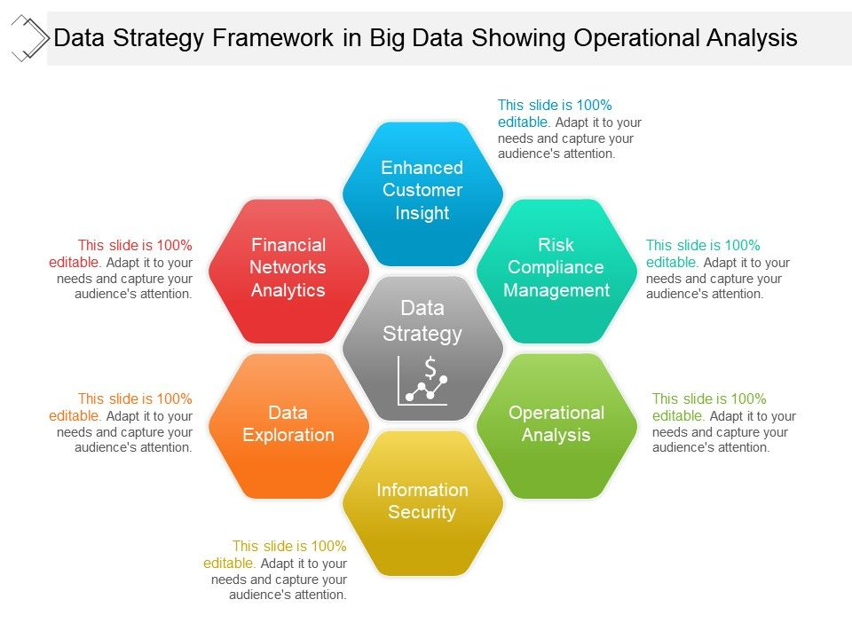
PROPOSED ARCHITECTURE DESIGN:-

Slide 5
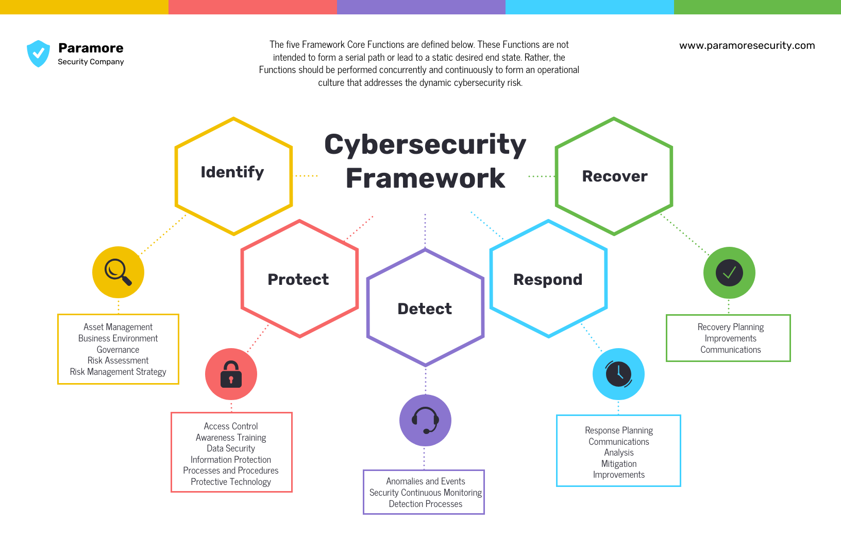

Slide 6
KEYWORDS:-
Confidentiality , Integrity , Availability, Efficient data processing , Encryption, Data masking, Privacy.
FUNCTIONALITY:-
Encryption: Encrypt data during ingestion to protect it in transit.
Validation: Validate incoming data to ensure it meets security criteria.
Access Control: Implement role-based access control (RBAC) and multi-factor authentication (MFA).
Data Masking/Anonymization: Mask sensitive data and anonymize personal data for non-production use.
Data Masking: Mask sensitive information in analysis and visualization outputs when necessary.

Slide 7
ARCHITECTURE DESIGN:-
Data Sources Layer
Secure data ingestion using encryption (SSL/TLS) to protect data in transit.
Validate and sanitize incoming data to prevent injection attacks.
Implement fine-grained access control (RBAC/ABAC) to limit who can provide and access data.
2. Data Storage Layer
Encrypt data at rest using robust encryption standards (e.g., AES-256).
Use data partitioning and separate storage for sensitive data.
Regularly back up data and use replication to ensure availability and durability.
Encrypt backups and store them in different geographical locations.
3. Data Processing Layer
Use secure and compliant data processing frameworks (e.g., Apache Hadoop, Apache Spark).
Ensure frameworks are configured to enforce security policies.
Process data in an encrypted form whenever possible.
Utilize hardware security modules (HSMs) for encryption key management.
4. Network Security Layer
Use VPNs and private networks to protect data in transit.
Implement network segmentation to isolate critical systems.
Deploy firewalls and intrusion detection/prevention systems to monitor and control network traffic.
Use DDoS protection services to safeguard against denial-of-service attacks.

Slide 8
Layout Design:-
Header:-
Title: Comprehensive Security Strategy for Big Data
Subtitle: Ensuring Data Confidentiality, Integrity, and Availability
Sections:-
Overview: Brief description of objectives and importance.
Security Framework: Introduction to the core components (Identify, Protect, Detect, Respond, Recover).
Main Body:-
Objectives
Key Words
Color Code
Functionality
User-Friendly Design:-
Color-Coded Sections: Use the specified colors for each core component to visually differentiate and emphasize the focus areas.
Icons and Symbols: Integrate relevant icons (e.g., shield for Protect, magnifying glass for Identify) to enhance understanding.
Interactive Elements: Include hyperlinks for detailed guidelines, policies, and external resources.
Consistent Layout: Maintain a consistent layout across all sections to ensure a cohesive reading experience.

Slide 9
PROGRAM/CODING:-
Language Selection
C++ code:
Easy to learn and use, which helps in rapid development.
Extensive libraries for cryptography, data processing, and security.
Widely used in data analytics, making it suitable for big data environments.
Algorithm/Program
The program will include the following components:
Data Encryption/Decryption for confidentiality.
Hashing for integrity verification.
Basic Access Control for ensuring only authorized access.
Logging and Monitoring for maintaining availability and tracking activities.
EXECUTION:-
#include <iostream>
#include <string>
#include <unordered_map>
class AccessControl {
private:
struct UserData {

Slide 10
std::string role;
std::string password;
};
std::unordered_map<std::string, UserData> users;
public:
AccessControl() {
// Initialize with predefined users, roles, and passwords
users["alice"] = {"analyst", "alice_password"};
users["bob"] = {"engineer", "bob_password"};
// Add more users and roles as needed
}
bool authenticateUser(const std::string& username, const std::string& password) const {
auto it = users.find(username);
if (it != users.end()) {
return it->second.password == password;
}
return false;

Slide 11
}
};
int main() {
AccessControl accessControl;
std::string username;
std::string password;
std::string roleRequired;
// Get input from the user
std::cout << "Enter username: ";
std::cin >> username;
std::cout << "Enter password: ";
std::cin >> password;
std::cout << "Enter required role: ";
std::cin >> roleRequired;
// Authenticate user first
if (accessControl.authenticateUser(username, password)) {
// If authentication succeeds, check access for the specified role

Slide 12
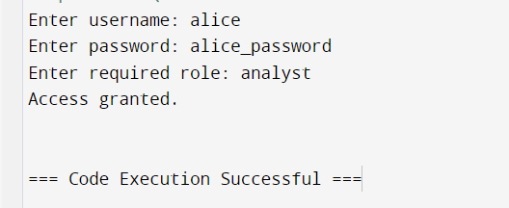
if (accessControl.checkAccess(username, roleRequired)) {
std::cout << "Access granted.\n";
} else {
std::cout << "Access denied: User does not have the required role.\n";
}
} else {
std::cout << "Access denied: Invalid username or password.\n";
}
return 0;
}
OUTPUT

Slide 13
IMPLEMENTATION:-
Connecting the Components
Data Encryption/Decryption:
AES encryption for data confidentiality.
Using a key management service (KMS) for secure key storage.
Integrity Verification:
SHA-256 hashing to verify data integrity.
Access Control:
Using an identity and access management (IAM) system.
Logging and Monitoring:
Centralized logging with monitoring tools to detect and respond to security incidents.
Cloud Deployment
AWS Account:
Create an AWS account if you don't have one.
Configure AWS CLI for local management.
IAM Configuration:
Define roles and permissions using IAM to control access to resources.
Enable multi-factor authentication (MFA) for added security.
Key Management:
Create and manage keys using AWS KMS.
Define key policies to control access to encryption keys.

Slide 14
Project Testing
Testing Procedure
Encryption/Decryption Testing:
Upload a test file to the S3 bucket and verify encryption.
Download the file, decrypt it, and compare with the original.
Integrity Testing:
Compute the SHA-256 hash of the original and decrypted files.
Ensure the hashes match to verify integrity.
Access Control Testing:
Attempt to access resources with different IAM roles.
Verify that access is granted/denied according to policy.
Logging and Monitoring Testing:
Generate logs by performing various actions.
Check CloudWatch for proper log entries and alerts.

Slide 15
PERFORMANCE EVALUATION:-
Performance Metrics Summary
Encryption Time: Time taken to encrypt data.
Decryption Time: Time taken to decrypt data.
Hash Computation Time: Time taken to compute the hash of the data.
Data Processing Time: Time taken to process the data (simulated by reversing the data).
Integrity Verification: Checking if the original data matches the decrypted data and verifying the integrity of the downloaded file from S3.
Encryption and Decryption:
Measures the time taken to encrypt and decrypt the data using AES encryption.
Uses a randomly generated salt and a key derived from a password for encryption.
Hash Computation:
Measures the time taken to compute the SHA-256 hash of the data for integrity verification.
Data Processing:
Simulates data processing by reversing the data and measuring the time taken.
Integrity Verification:
Computes and compares the hashes of the original and decrypted data to ensure data integrity.
Verifies the integrity of the uploaded and downloaded file from S3 by comparing hashes.
Cloud Storage and Retrieval:
Uploads the file to an AWS S3 bucket and measures the integrity of the file after downloading it back.

Slide 16
CONCLUSION:-
The integrated performance evaluation of the security strategy for managing and protecting big data in a large-scale analytics environment provides a comprehensive assessment of its effectiveness and efficiency. The evaluation measures key performance metrics such as encryption and decryption times, hash computation times, data processing times, and integrity verification. By systematically testing these components, the strategy ensures that data confidentiality, integrity, and availability are maintained without significantly impacting the performance of data processing tasks. The use of AWS services for cloud deployment further enhances the robustness and scalability of the solution.
The results from the evaluation script demonstrate that the implemented security measures effectively protect data from unauthorized access and ensure data integrity. The time metrics provide insights into the overhead introduced by these security mechanisms, enabling optimization and fine-tuning for better performance. Overall, this integrated evaluation framework not only validates the security strategy but also offers a practical approach to maintaining high levels of security and efficiency in big data analytics environments.

Slide 17


